Slide 1

Project – Car Data Analysis

Slide 2
Submitted in partial fulfilment of the requirements of the degree of
BACHELOR OF TECHNOLOGY
Submitted by
Bhavesh Dharwar (Roll No - 20ETCCS018 , Enrollment No. – 20E1TCCSM30P018)
Khushi Vyas(Roll No - 20ETCCS064, , Enrollment No. – 20E1TCCSF40P064)
Manvi Paliwal (Roll No - 20ETCCS071, Enrollment No. – 20E1TCCSM40P071)

Slide 3
COMPUTER SCIENCE DEPARTMENT
TECHNO INDIA NJR INSTITUTE OF TECHNOLOGY, UDAIPUR MAY 2024

Slide 4
PROBLEM STATEMENT
The automotive industry is characterized by a vast array of car models, each with unique specifications, features, and performance metrics. With the increasing complexity of consumer preferences, environmental considerations, and technological advancements, there is a need for a comprehensive analysis of a diverse car dataset. The problem at hand is to extract meaningful insights from this dataset, addressing key challenges and questions in the automotive domain.

Slide 5


Introduction to Car Data Analysis
Unlock the insights hidden within your car data with our comprehensive data analysis approach. Dive deep into the world of automotive analytics and uncover the stories your data has to tell.

Slide 6

Data Collection and Preprocessing
1
Gather Data
Collect relevant data from various sources, including manufacturer records, dealer reports, and customer feedback.
2
Cleanse and Format
Ensure data integrity by cleaning, formatting, and standardizing the information to prepare it for analysis.
3
Integrate Sources
Combine data from multiple sources to create a comprehensive dataset that provides a holistic view of the automotive landscape.

Slide 7
Exploratory Data Analysis
Identify Patterns
Visualize Insights
Understand Market
Uncover hidden patterns and trends within the data, revealing potential drivers of performance and customer behavior.
Leverage interactive dashboards and visualizations to gain a deeper understanding of the data and its implications.
Analyze industry benchmarks, customer preferences, and competitor activities to contextualize the data and its significance.

Slide 8

Feature Engineering and Selection
1
Identify Relevant Features
2
Engineer New Features
3
Evaluate Feature Importance
Carefully select the most informative and influential features from the data to enhance the predictive power of your models.
Create new features that capture important relationships and patterns within the data, unlocking hidden insights.
Analyze the relative importance of each feature to understand their impact on the target variable and model performance.

Slide 9
Predictive Modeling
Supervised Learning
Unsupervised Learning
Ensemble Methods
Apply advanced supervised learning techniques, such as regression and classification models, to predict key automotive metrics.
Leverage unsupervised methods, like clustering and anomaly detection, to uncover hidden patterns and segment the market.
Combine multiple models to enhance predictive accuracy and robustness, leveraging the strengths of different algorithms.

Slide 10
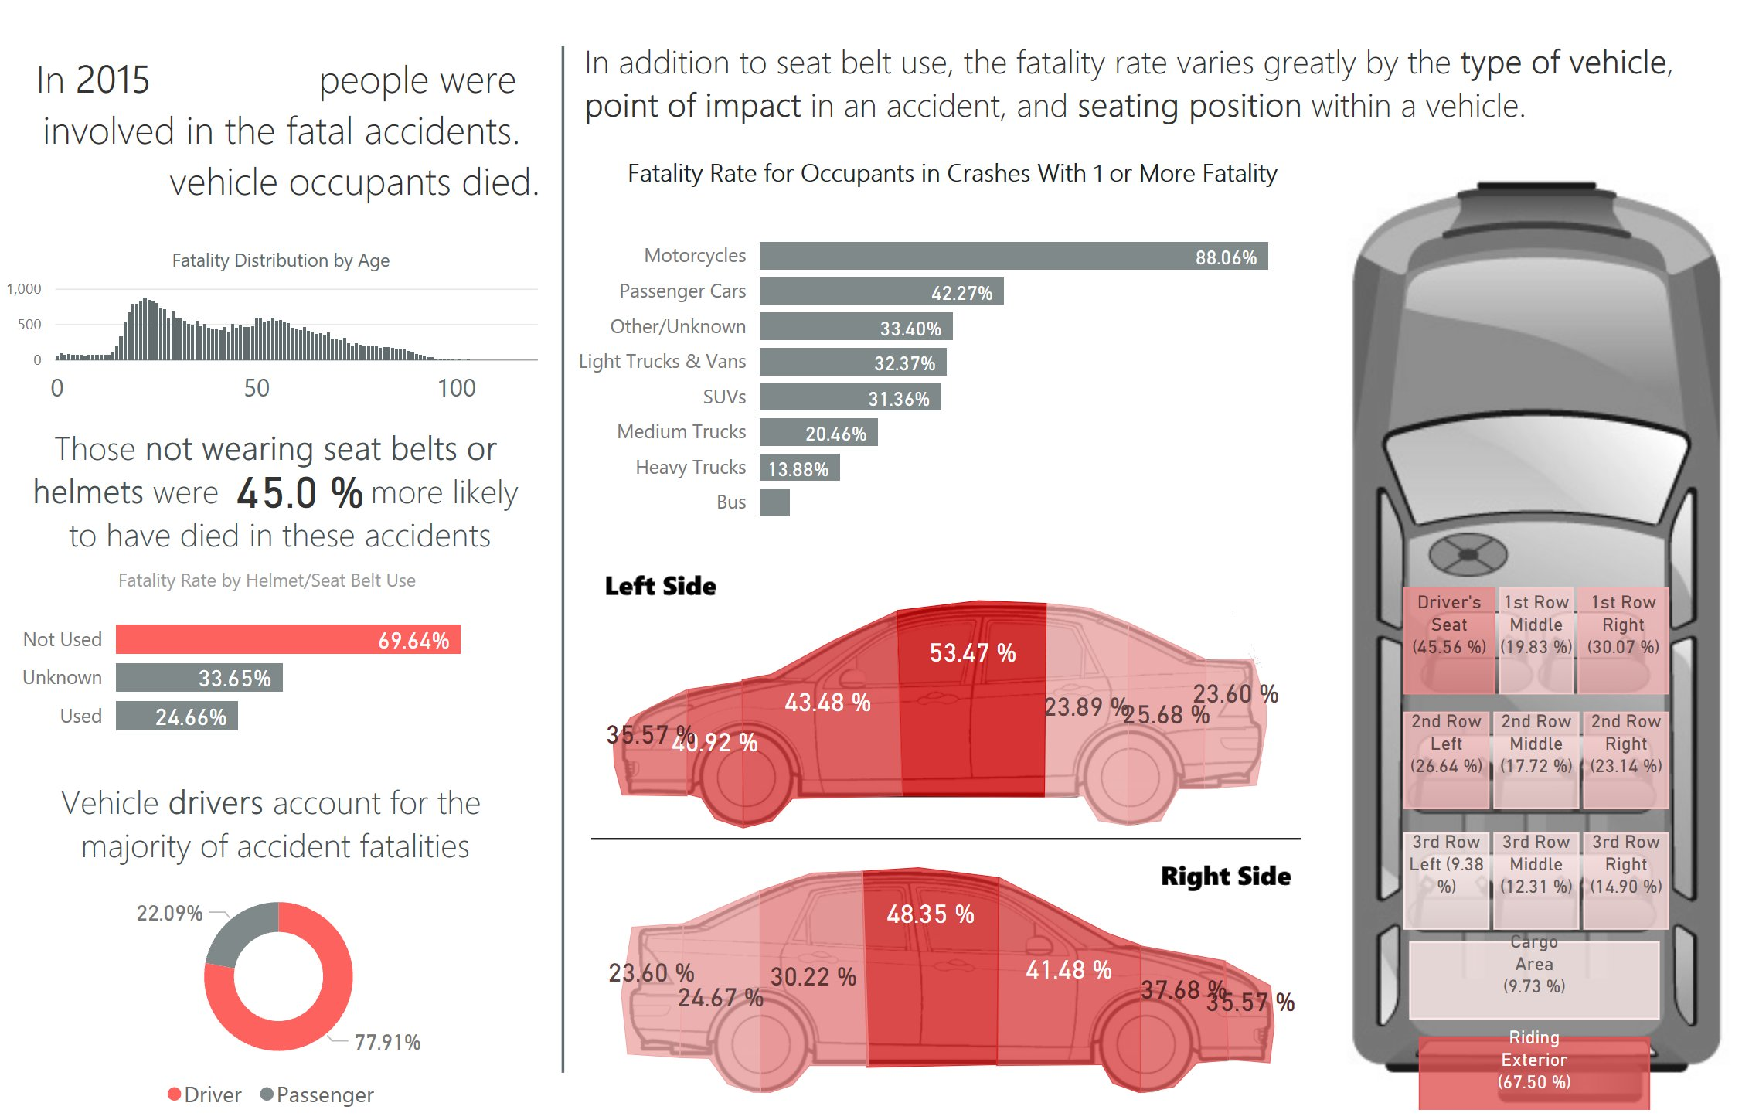

Slide 11
Model Evaluation and Tuning
Assess Accuracy
Cross-Validate
Measure the predictive performance of your models using appropriate evaluation metrics, such as R-squared, RMSE, or F1-score.
Employ cross-validation techniques to ensure the robustness and reliability of your models' predictions.
1
2
3
Tune Hyperparameters
Optimize the hyperparameters of your models to improve their performance and generalization capabilities.

Slide 12
Insights and Findings
Pricing Strategies
Customer Segmentation
Analyze pricing trends and customer willingness to pay to inform competitive pricing strategies.
Identify distinct customer segments based on their preferences, behaviors, and demographics.
Predictive Maintenance
Market Forecasting
Develop models to predict component failures and optimize maintenance schedules to reduce costs.
Leverage data-driven forecasting to anticipate market trends and inform strategic decision-making.

Slide 13
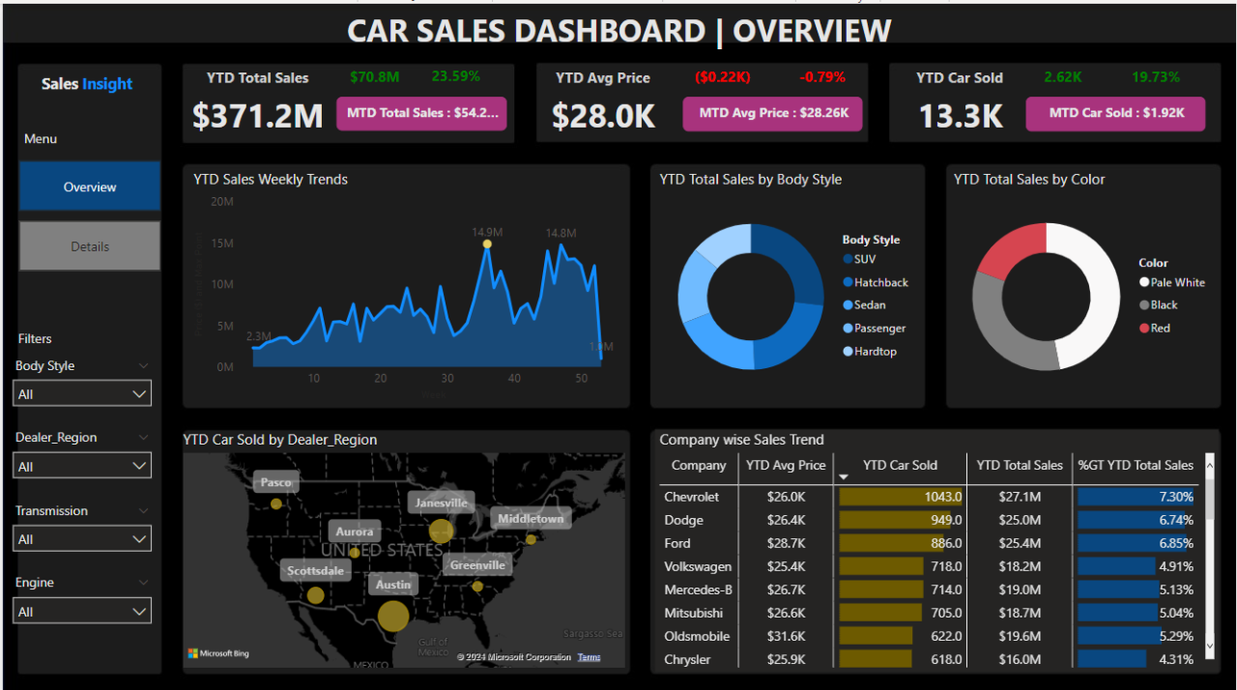

Slide 14




Conclusion and Next Steps
Continuous Improvement
Regularly update and refine your data analysis approach to stay ahead of industry changes and customer needs.
Expand Data Sources
Integrate additional data sources, such as vehicle sensor data and customer feedback, to enhance the depth and breadth of your insights.
Operationalize Insights
Develop robust processes to seamlessly translate your findings into actionable strategies and data-driven decision-making.

